Slide 1


Basics of Statistics
Made Easy

Slide 2
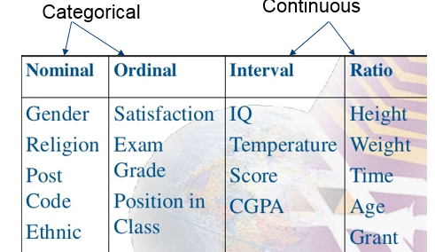
Quick Recap:
Statistics = Descriptive Statistics + Inferential Statistics
Variable and Constants
Variables => Catergorical + Numerical
Dataset = Rows and Columns: ROW => Records, Observations, Sample, Datapoint & COL=> Feature, Variable, Columns
Discrete Variable = Fixed number of object. Example : Number of students or Total of Produts.
Continous Variable = Continue precise value. Example: Weight of person or total Distance like 50.6 pounds or 20.3 miles.
Indepdent Variable and dependent Variable
Population & Sample: Types of samples > simple random sampling, stratified sampling, cluster sampling
Types of Data > Quantitative(Continous & Discrete) + Qualitative(Binomial, Nominal, Ordinal)CATERGORICAL
Continous = Interval + Ratio
Data Analysis Process = Collect>Prepare>Structure>Organize>Present>Visualize>Graph = Descriptive Statistics
Inferential Statiscs = DAP + Explore Releationship between variables and compare groups

Slide 3


statistical Components
Univariate Analysis :
Frequency Distribution,
Measure Of Central Tendency,
Measure of Variability

Slide 4
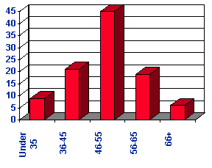
There are 3 main types of descriptive statistics
Uni-Variate Analysis:
Univariate analysis is defined as analysis carried out on only one (“uni”) variable (“variate”) to summarize or describe the feature. “The Examination of the distribution of cases on only one variable at a time”
However, another use of the term “univariate analysis” exists and refers to statistical analyses that involve only one dependent variable and which are used to test hypotheses and draw inferences about populations based on samples, also referred to as univariate statistics.
We may set up margins that allow us to group cases into categories Ex: AGE
Univariate analyses are contrasted with bivariate analyses (analyses involving two variables)
and multivariate analyses (analyses of two or more variables simultaneously).

Slide 5
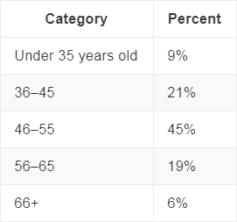

Uni-Variate Analysis Components
Frequency Distribution
Measure of Central Tendency
Measure of variability or Dispersion
The distribution is a summary of the frequency of individual values or ranges of values for a variable
A typical way to describe the distribution of college students is by year in college
It is an estimate of the “center” of a distribution of values. There are three major types of estimates of central tendency:
Mean
Median
Mode
Dispersion refers to the spread of the values around the central tendency.
There are two common measures of dispersion the range and the standard deviation
Range
Variance
Standard Deviation

Slide 6
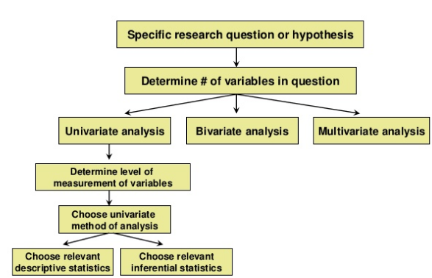
Flow understanding

Slide 7

Analysis outlook
UniVariate Analysis
Descriptive Statistics
Inferential Statistics
Measure of Central Tendency
Mean
Median
Mode
Measure of Dispersion
Range
Variance
Standard Deviation
T-Test
Z-Test
Chi-Square Test

Slide 8
Measure of Central Tendency
A measure of central tendency is a single value that attempts to describe a set of data by identifying the central position within that set of data. As such, measures of central tendency are sometimes called measures of central location. They are also classed as summary statistics. The mean (often called the average) is most likely the measure of central tendency that you are most familiar with, but there are others, such as the median and the mode.
The mean, median and mode are all valid measures of central tendency, but under different conditions, some measures of central tendency become more appropriate to use than others.
Mean: The mean (or average) is the most popular and well known measure of central tendency. It can be used with both discrete and continuous data
This formula is usually written in a slightly different manner using the Greek capitol letter, ∑, pronounced "sigma", which means "sum of":
Suppose 15 => x1 and 3 => x2, 12 => x3, 0 =>x4, 24 => x5, 3 => xn, Always Last element has Xn.

Slide 9




Mean
Population means is denoted as Greek lower letter MU “ ”
Example: 15, 3, 12, 0, 24, 3 Total number of values is 6 and its Denoted By n (small n)
15 + 3 + 12 + 0 + 24 + 3 = 57, Zero is also a value. Null is not a value, ex “nan”
Sample Mean is denoted by X bar
Our Dataset 15, 3, 12, 0, 24, 3
N Value is 6 and is 57. Finally . 57/6 = > 9.5

Slide 10
Mean
Finding Mean: Add the numbers up to get a total. Example: 2 +19 + 44 + 44 +44 + 51 + 56 + 78 + 86 + 99 + 99 = 622.
Set this number aside for a moment.
Count the amount of numbers in the series. In our example (2, 19, 44, 44, 44, 51, 56, 78, 86, 99, 99), we have 11 numbers.
Divide the number you found by the number you found above In our example: 622 / 11 = 56.5454545. This is the mean, sometimes called the average.

Slide 11
Types of mean
Arithmetic Mean
Geometric Mean
Harmonic Mean
Quadratic Mean
Trimmed Mean
Weighted Mean
Combination Mean

Slide 12
Median
The median is the middle point in a dataset—half of the data points are smaller than the median and half of the data points are larger
To find the median:
Arrange the data points from smallest to largest.
If the number of data points is odd, the median is the middle data point in the list.
If the number of data points is even, the median is the average of the two middle data points in the list.

Slide 13
Examples for Median
Find the median of this data: 1,4,2,5,0
Put the data in order first: 0,1,2,4,5
There is an odd number of data points, so the median is the middle data point.
0, 1, 2, 4, 5
The median is 2.

Slide 14
Examples for Median
Find the median of this data: 0, 3, 3, 12, 15, 24
Middle Numbers: 3,12
There is an Even number of data points, (3 + 12)/2 = 7.5
The median is 7.5.

Slide 15
Examples for MODE
The mode is the most commonly occurring data point in a dataset. The mode is useful when there are a lot of repeated values in a dataset.
There can be no mode, one mode, or multiple modes in a dataset.
What is the mode of the following numbers?
10,6,4,4,6,4,1
Answer) Mode is 4

Slide 16
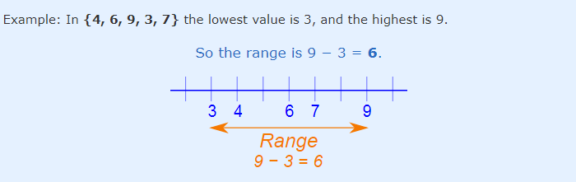
Measure of variability or Dispersion
Range
The Range is the difference between the lowest and highest values

Slide 17
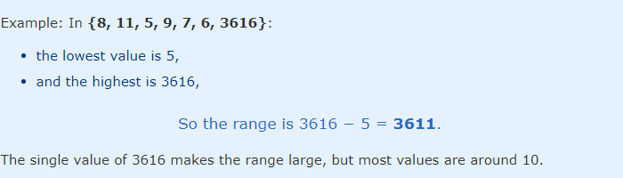
Measure of variability or Dispersion
Range
The Range Can Be Misleading
The range can sometimes be misleading when there are extremely high or low values.
Outlier

Slide 18
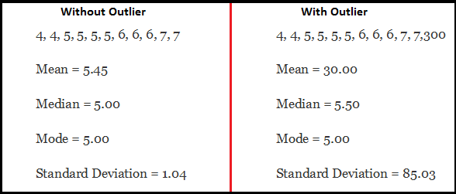
Measure of variability or Dispersion
Range
Outlier:
An outlier is an observation that lies an abnormal
distance from other values in a random sample
from a population. In a sense, this definition leaves
it up to the analyst (or a consensus process) to decide
what will be considered abnormal. Before abnormal
observations can be singled out, it is necessary to
characterize normal observations.

Slide 19
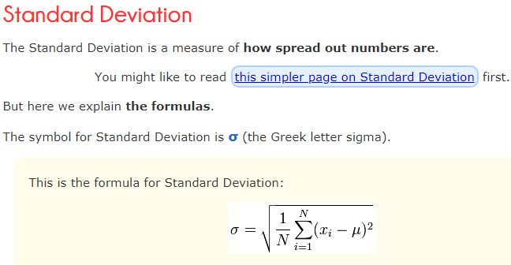
Measure of variability or Dispersion
Standard Deviation
Standard Deviation: A quantity expressing by how much the members of a group differ from the mean value for the group

Slide 20
Measure of variability or Dispersion
Standard Deviation
OK. Let us explain it step by step.
Say we have a bunch of numbers like 9, 2, 5, 4, 12, 7, 8, 11.
To calculate the standard deviation of those numbers:
1. Work out the Mean (the simple average of the numbers)
2. Then for each number: subtract the Mean and square the result
3. Then work out the mean of those squared differences.
4. Take the square root of that and we are done!
The formula actually says all of that, and I will show you how.

Slide 21

Thank you
Mohammed Azharuddin
Analyst
FSA
praticallabs12@gmail.com (Google drive) forpractise

